Slide 1

www.tinyurl.com/djw-stat

Slide 2
Thinking Data
Yas Suttakulpiboon: Chulalongkorn Business School

Slide 3

Isariya (Yas) Suttakulpiboon
PhD Risk Management and Insurance
Georgia State University
MSc Mathematical Risk Management
Georgia State University
BA Economics (Summa Cum Laude)
Thammasat University
Working Experience:
Tax & Trade Policy Consulting
Lecturer at Georgia State University
Guest lecturers at Thammasat U, NIDA,
Siam U, PSU, Naresuan U
Risk workshops for PTT, PTG, TRUE, CPF, TIP,
SCB, KTB, GSB and others
Research Interest:
Insurance Economics
Enterprise Risk Management
Risk Modelling

Slide 4


Slide 5


Slide 6


Slide 7


Slide 8
Thinking Data
AM
Asking Game
The “Right” Questions
Data Value Canvas
PM
Exploring Deeper Insights in your Data

Slide 9
“The Right Questions help your audience make better decision for their lives/organizations/communities”

Slide 10
Asking Game

Slide 11
แบ่งทีมกันครับ

Slide 12

This Photo by Unknown Author is licensed under CC BY-SA

Slide 13







Slide 14
ข้อมูลที่ให้มา
Row ID: หมายเลขแถวข้อมูล
Domain Name: ชื่อ Website ทำการใช้บัตร
Referring Domain Name: ชื่อ Website อ้างอิงก่อนการใช้บัตร
View Pages: จำนวนหน้าเข้าชม ณ Domain Name (รวมการขั้นตอนการใช้บัตร)
View Duration: จำนวนนาทีเข้าชม ณ Domain Name (รวมการขั้นตอนการใช้บัตร)
Trans Date: ปี-เดือน-วันที่ การใช้บัตร
Trans Hours: ชั่วโมงนาฬิกา (หน่วย 24 ชั่วโมง) การใช้บัตร

Slide 15
ข้อมูลที่ให้มา
Product Name: รายละเอียดของสินค้า / บริการ
Product Category: หมวดของสินค้า / บริการ
Product Sub-Category: หมวดย่อยของสินค้า / บริการ
Total Spending: ค่าใช้จ่ายของสินค้า / บริการ ผ่านบัตร Credit
Household Size: จำนวนคนในครอบครัวของผู้ถือบัตร
Income: กลุ่มรายได้ของผู้ถือบัตร
Income Text: คำอธิบายกลุ่มรายได้ผู้ถือบัตร
Have Children: ผู้ถือบัตรมีบุตรหรือไม่
Zip Code: ที่อยู่ของผู้ถือบัตร

Slide 16
กรณีศึกษา ข้อมูลการใช้บัตร Credit Card
ข้อมูลการใช้บัตร Credit บนร้านค้า Online บางส่วนของธนาคาร A ในเดือน พฤศจิกายน 2561
ถ้าเราอยากทำข่าวจากข้อมูลนี้...
“เราจะเล่าเรื่องอะไรดีเพื่อให้เป็นประโยชน์แก่ผู้อ่าน?”

Slide 17
“เราจะเล่าเรื่องอะไรดีเพื่อให้เป็นประโยชน์แก่ผู้อ่าน?”

Slide 18
Asking Game
ให้แต่ละทีมช่วยกันคิดว่าถ้าต้องการ สร้างประโยชน์จากข้อมูล แต่ละทีมจะต้อง ถามคำถาม อะไรบ้าง? โดยจะต้องเป็นคำถามที่สามารถตอบได้โดยข้อมูลที่ให้มาเท่านั้น
สุ่มแต่ละทีมถามทีมละ 1 คำถามไม่ซ้ำกันเพื่อให้ผมตอบคำถามผ่าน Excel
แล้วเราจะมาค้นพบกันว่า คำถามที่ดีและนำไปสู่เรื่องราวที่สร้างประโยชน์ได้จริง ควรเป็นคำถามแบบใด

Slide 19
ถามไปทำไม
ผู้รับสารจะได้อะไร
ถาม
ชัด
วัดได้
ไม่ซับซ้อนเกินไป
เก็บ + ต่อยอด
มันแปลว่าอะไร
ใช่จริง ๆ มั้ย
เจอ
เจอ Insight อะไรใหม่มั้ย
ทำไมถึงไม่เจอ
ไม่เจอ
ทิ้ง

Slide 20
Discussion Time

Slide 21
Digging Insights with Data

Slide 22
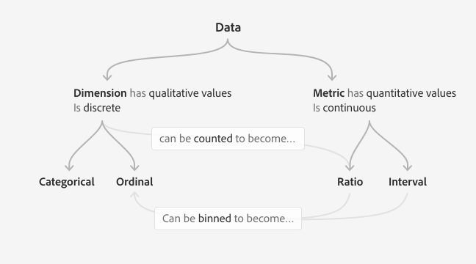
Source: https://spectrum.adobe.com/page/data-visualization-fundamentals/

Slide 23
SCALE | CATEGORICAL | ORDINAL | INTERVAL | RATIO
Example | Country (US, Japan, Mexico) | Status (Extinct, Endangered, Threatened) | Time Interval (1999, 2019) | Height (1.65 m, 3.1 m, 2.01 m.)
The ranking of the values is known |  | x | x | x
Has a mode (most frequent value) | x | x | x | x
Has a median (middle value) Has a percentile |  | x | x | x
Has a mean (average value) |  |  | x | x
Can quantify the difference between values |  |  | x | x
Has a spread (standard deviation, variance) |  |  |  | x
Can multiply and divide values |  |  |  | x
Has a “true” zero |  |  |  | x
Source: https://spectrum.adobe.com/page/data-visualization-fundamentals/

Slide 24
กรอง
เจาะ
เทียบ
ชน

Slide 25
กรอง
เจาะ
เทียบ
ชน
เอาข้อมูลที่
“ไม่สำคัญ” หรือ “สกปรก” ออกไป
ดูตัวแปรเดียวอย่างละเอียด เช่น ความถี่ ผลรวม ค่าเฉลี่ย การกระจายข้อมูล ตำแหน่งข้อมูล
เปรียบเทียบระหว่างตัวแปรเดียวกันในหลายประเภท/ชนิด หรือดูสัดส่วน
ดูความสัมพันธ์ระหว่างตัวแปรสองตัวขึ้นไป

Slide 26
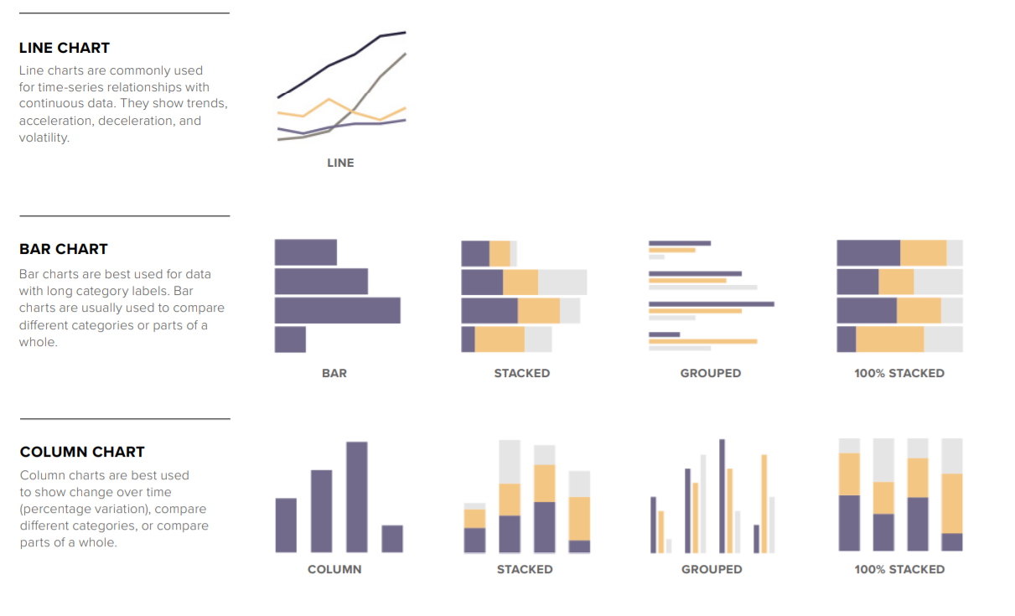
Source: https://github.com/glosophy/CatoDataVizGuidelines/blob/master/PocketStyleBook.pdf

Slide 27
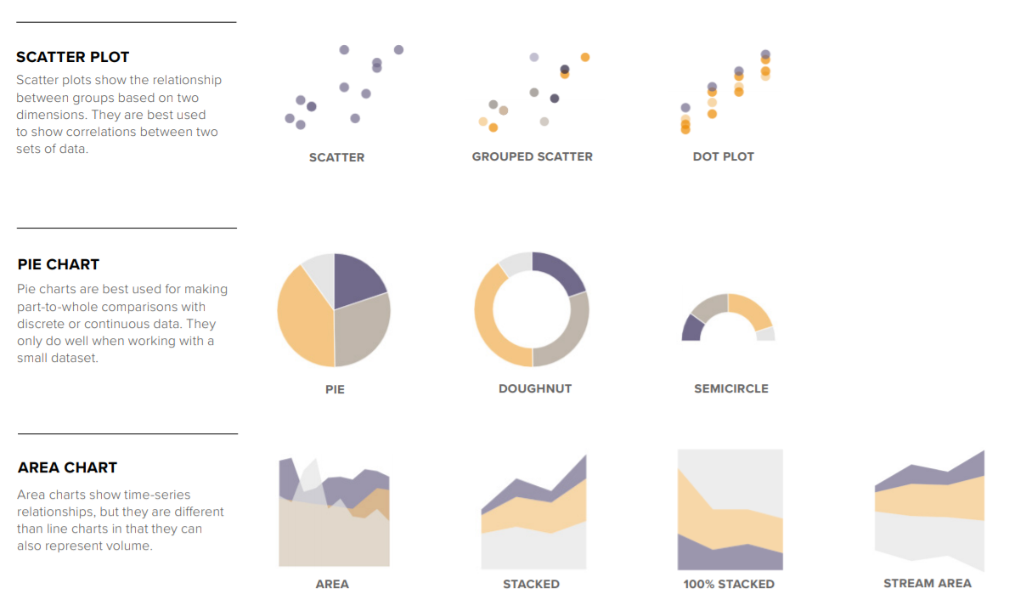
Source: https://github.com/glosophy/CatoDataVizGuidelines/blob/master/PocketStyleBook.pdf

Slide 28
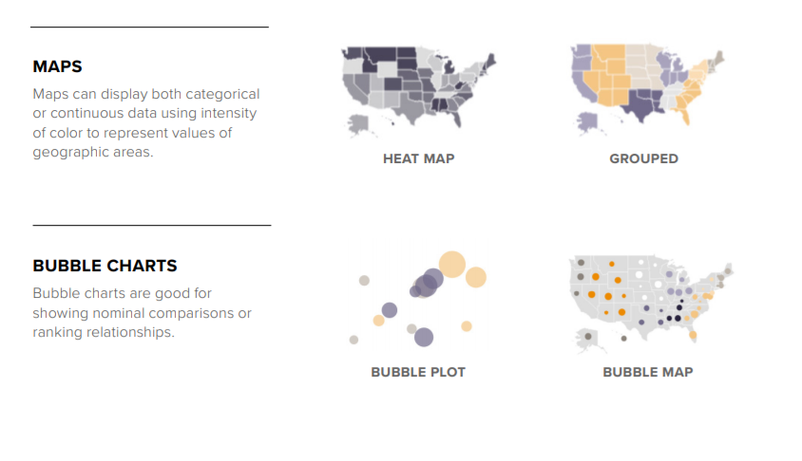
Source: https://github.com/glosophy/CatoDataVizGuidelines/blob/master/PocketStyleBook.pdf

Slide 29
ถามไปทำไม
ผู้รับสารจะเอาข้อมูล
ไปทำอะไรต่อ
ถาม
ชัด
วัดได้
ไม่ซับซ้อนเกินไป
เก็บ + ต่อยอด
มันแปลว่าอะไร
ใช่จริง ๆ มั้ย
เจอ
เจอ Insight อะไรใหม่มั้ย
ทำไมถึงไม่เจอ
ไม่เจอ
ทิ้ง

Slide 30
Data Value Canvas

Slide 31


Slide 33
Audience Value Generation
What’s your audience’s goal?
What insights they need to know to inform / make decisions?
How they can generate values using insights?
Data
Acquisition
What
Where
When
Who
How
How Many
Data
Integration
How “dirty”
is your data?
Analysis
List out exact
questions
and variables/models
needed
Potential bias and error
traps?
Delivery
Key visuals
Key statistics
Key takeaways
Data
Creator
Audience
Data Governance
Does your organization promote behaviors for good data practice?
Data Principles / Quality / Privacy / Life Cycle / Ethical Use

Slide 34
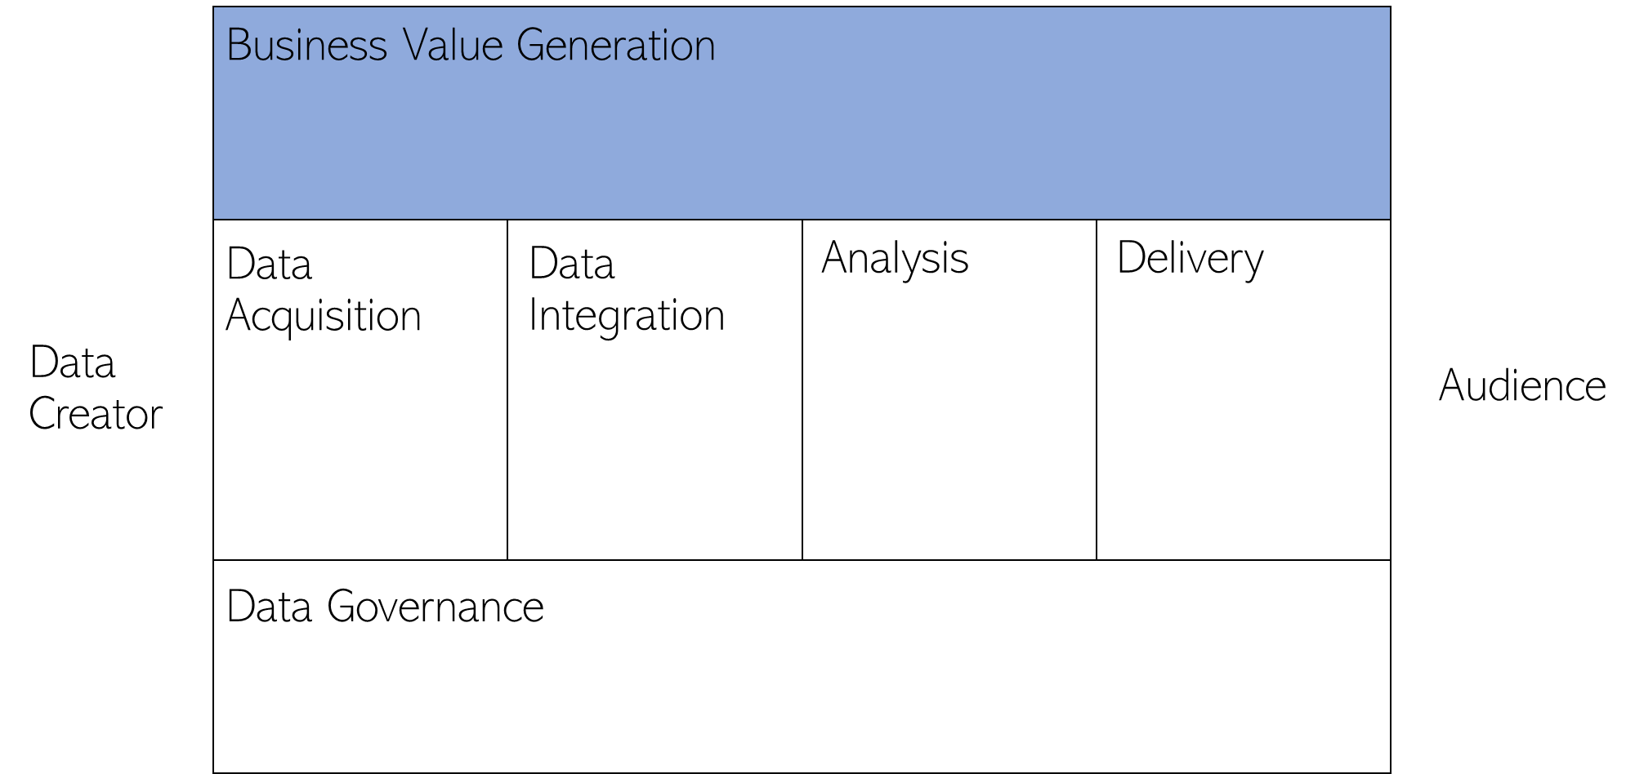
Audience Value Generation
Willingness to pay more?
Behavior? Growth/Size?
Increase
Revenue
Making Existing customer pay more?
Who?
Where? How?
Are these impactful / insightful / lead to audience use?

Slide 35
Audience Value Generation
Data
Acquisition
Data
Integration
Analysis
Delivery
Data
Creator
Audience
Data Governance

Slide 36
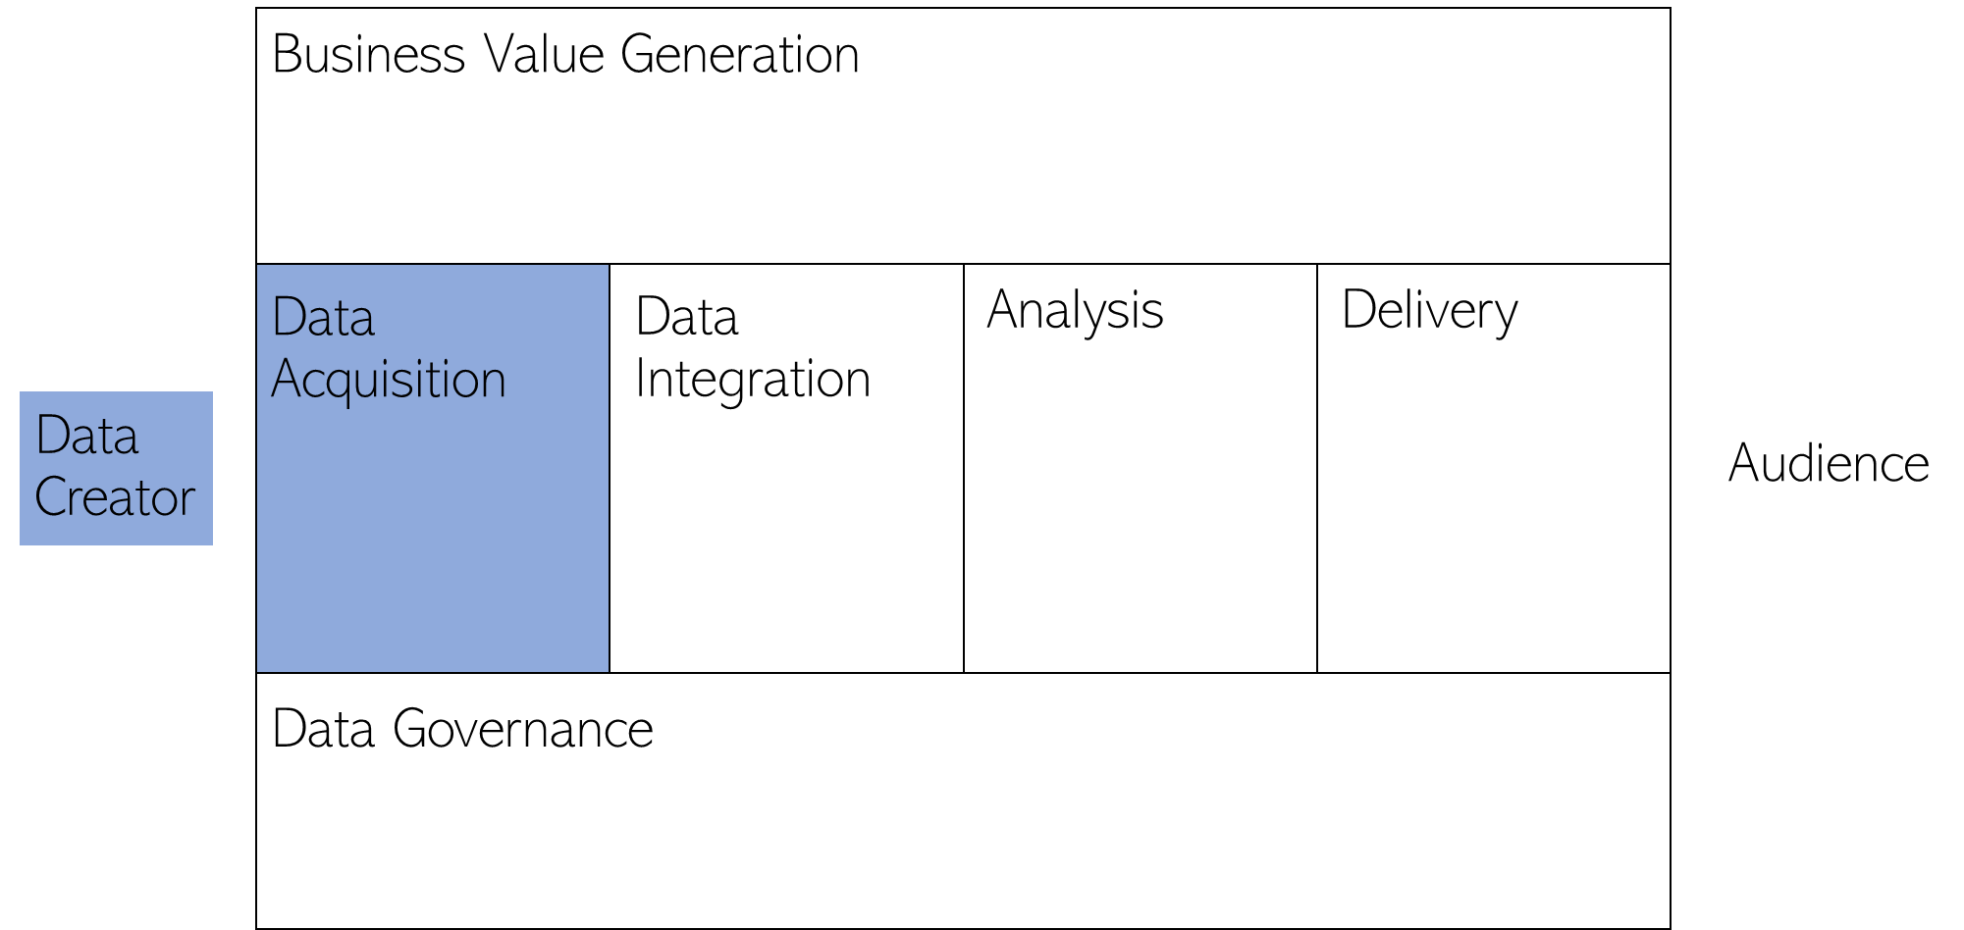
Internal / External?
Free / Costly to Acquire?
Reliable?
Data
Acquisition
Data
Creator
Survey
Third Party Database
Web Scraping / Social Hearing
Others

Slide 37
Data Acquisition
What Where When
Whom How
How many
Ensure wide/deep/logical/relevant data acquisition process

Slide 38
Audience Value Generation
Data
Acquisition
Data
Integration
Analysis
Delivery
Data
Creator
Audience
Data Governance

Slide 39
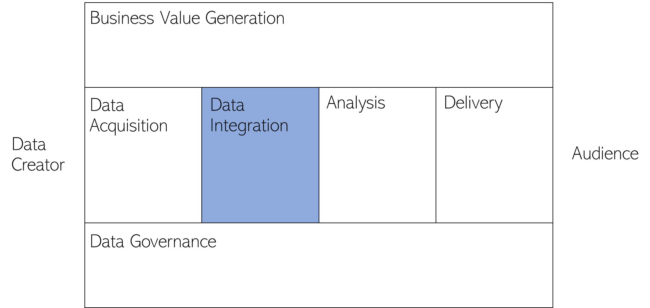
Dirty Data
Clean Data

Slide 40
Typos?
Outliers?
Outdated?
Duplicates?
Incorrect Field?
Missing Values?
Integrated Properly?
Represent Your Target?
Dirty Data
Clean Data

Slide 41
Audience Value Generation
Data
Acquisition
Data
Integration
Analysis
Delivery
Data
Creator
Audience
Data Governance

Slide 42
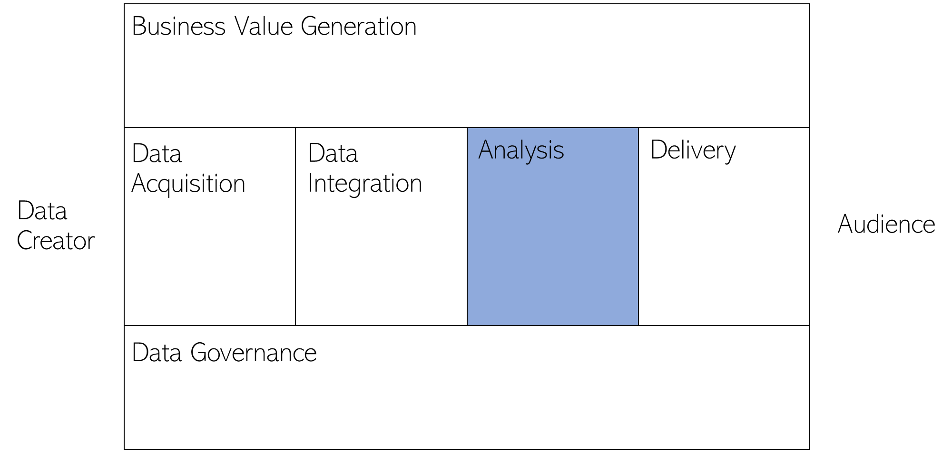
Analysis
Willingness to pay more?
Behavior? Growth/Size?
Increase
Revenue
Making Existing customer pay more?
Who?
Where? How?
List out the exact questions and variables needed to answer audience’s questions

Slide 43
Human Bias
Trap

Slide 44


Slide 45
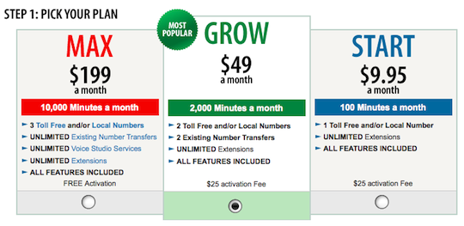

Slide 46
Human Bias
Trap
Anchoring Effect

Slide 47
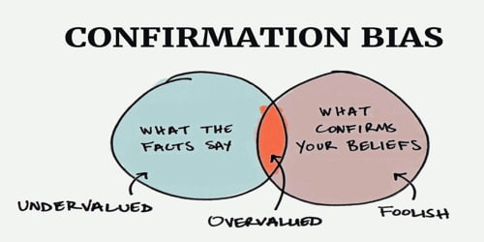

Slide 48
Human Bias
Trap
Confirmation Bias

Slide 49
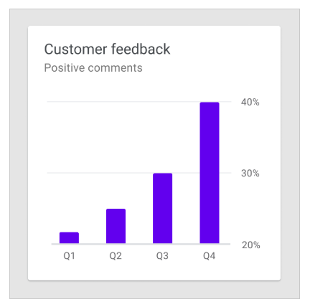

Slide 50
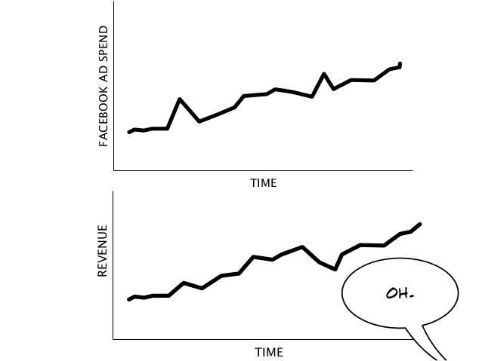

Slide 51
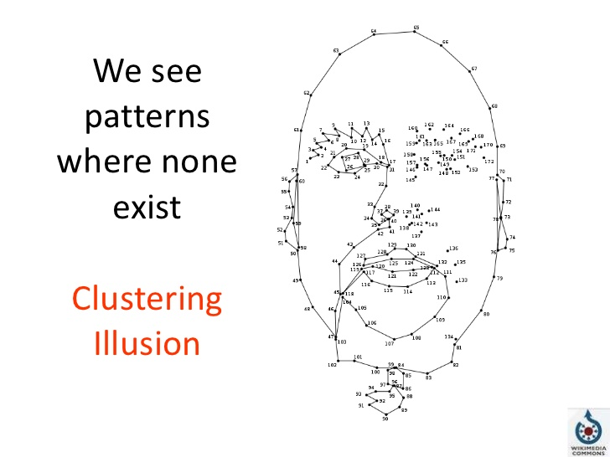

Slide 52
Human Bias
Trap
Anchoring Effect
Confirmation Bias
Clustering Illusion

Slide 53
Audience Value Generation
Data
Acquisition
Data
Integration
Analysis
Delivery
Data
Creator
Audience
Data Governance

Slide 54
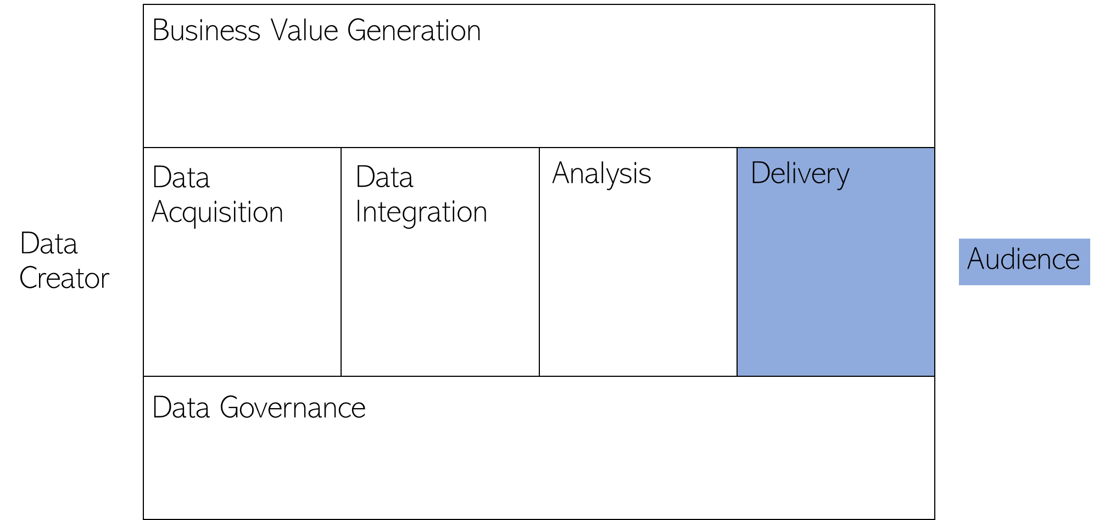
Delivery
Audience
“Know Your Data Audience”
Millennials
Baby Boomers
Thai SMEs
Policymakers
Others

Slide 55
Delivery
Audience
Key visuals
Key statistics
Key takeaways

Slide 56
Audience Value Generation
Data
Acquisition
Data
Integration
Analysis
Delivery
Data
Creator
Audience
Data Governance:
Promotion of behaviors for good data practice
Data Principles / Quality / Privacy / Life Cycle / Ethical Use

Slide 57
Question?

Slide 58
Dig Deeper Insights in your Data

Slide 59

Kids Explain Why Women Are Paid Less Than Men
Notes:
Play: https://youtu.be/S1Onniy08AY

Slide 60
Can you spot a relationship between %Women & Median Wage
Statistics of 2016 American Recent Graduates’ Median Wage and Share of Women
By Their Major of Studies (Source: Pew Research Center)

Slide 61
Can you spot a relationship between %Women & Median Wage
Actuarial Science

Slide 62

Case Study: Do wage gap exist among female millennials?

Slide 63
Better Tools to Explore Data Insights?

Slide 64
Regression = A statistical process for estimating the relationships among (random) variables
“Direction”
Positive relationship
Negative relationship
No relationship at all?
“Magnitude”
Large
Small
Zero

Slide 65
Why regression?
Regression is a standard way to show a relationship among variables
Regression is flexible to model the relationship
Regression is extremely useful in business & policymaking

Slide 66
Regression in 5 Steps
Frame the question & Form the hypotheses
Pick a regression model that could answer the question
Collect, clean, summarize & visualize the data
Use the model in (2) and data in (3) to run a regression
Evaluate & interpret the results
Iterate some or all of steps 1-5 if necessary

Slide 67
Case Study: Recent Grad’s Median Wage
Step 1: Frame the question & Form the hypotheses
Question: Does share of women in college major explains recent graduate’s median wage?
Hypothesis: Share of women in college major is negatively related to recent graduate’s median wage
Why?
Theory? Have other people looked into this? Your own observation?

Slide 68
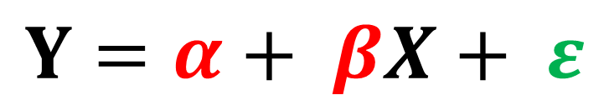
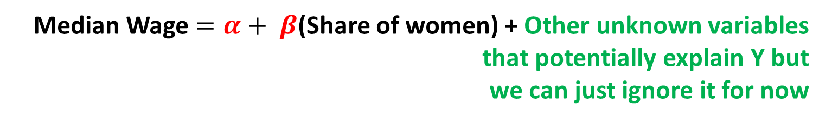
Case Study: Recent Grad’s Median Wage
Step 2: Pick a regression model that could answer the question
Question: Does share of women in college major explains recent graduate’s median wage?
Linear Regression Model:
X: Explanatory (Independent) Variable
Y: Dependent Variable
$$Y=α+ βX+ ε$$
Median Wage $=α+ β$(Share of women) + Other unknown variables
that potentially explain Y but
we can just ignore it for now

Slide 69
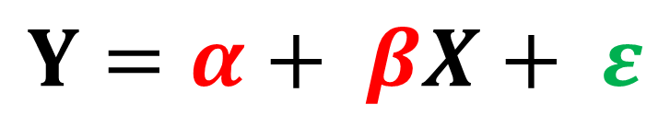
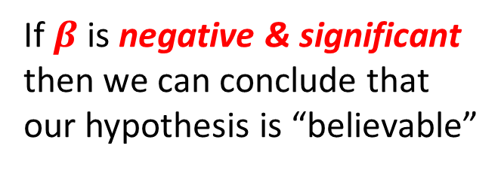
Case Study: Recent Grad’s Median Wage
Step 2: Pick a regression model that could answer the question
Hypothesis: Share of women in college major is negatively related to recent graduate’s median wage
$$Y=α+ βX+ ε$$
If $β$ is negative & significant
then we can conclude that
our hypothesis is “believable”

Slide 70
Step 3: Collect, clean, summarize & visualize the data
Statistics of 2016 American Recent Graduates’ Median Wage and Share of Women
By Their Major of Studies
Source: Pew Research Center

Slide 71

Step 3: Collect, clean, summarize & visualize the data
Median Wage $=α+ β$(Share of women)

Slide 72
Case Study: Recent Grad’s Median Wage
Step 4: Use the model in (2) and data in (3) to run a regression
Use Data Analysis >> Regression
Watch the videos again for detail

Slide 73
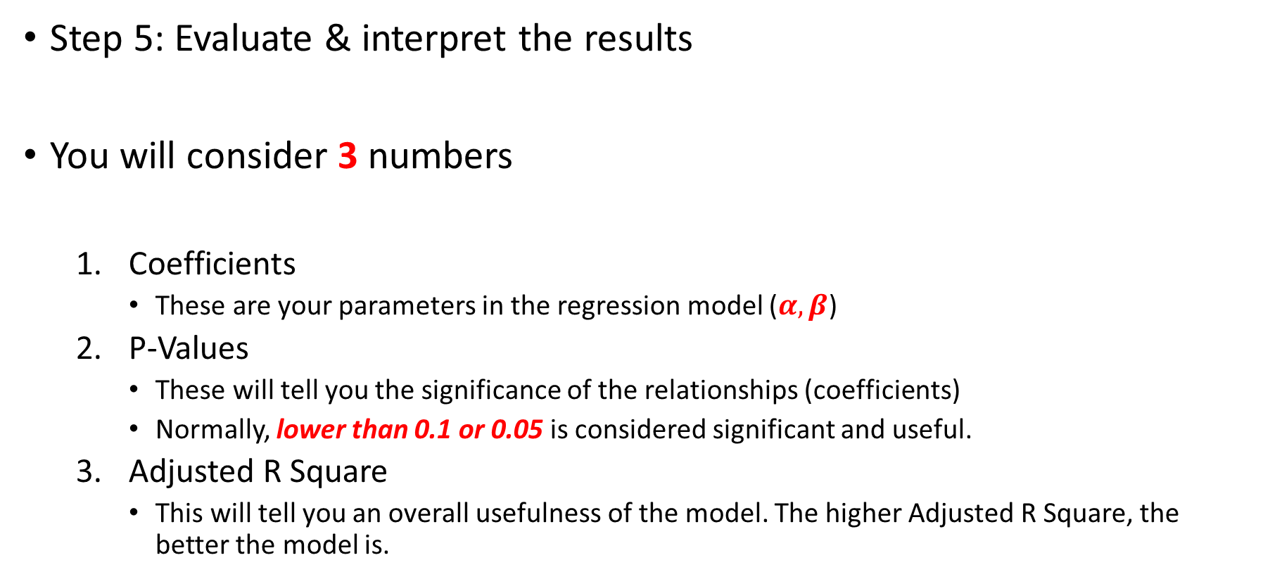
Case Study: Recent Grad’s Median Wage
Step 5: Evaluate & interpret the results
You will consider 3 numbers
Coefficients
These are your parameters in the regression model ($α, β$)
P-Values
These will tell you the significance of the relationships (coefficients)
Normally, lower than 0.1 or 0.05 is considered significant and useful.
Adjusted R Square
This will tell you an overall usefulness of the model. The higher Adjusted R Square, the better the model is.

Slide 74
Case Study: Recent Grad’s Median Wage
Regression Result
Regression Model:
Median Wage = 49270.2959 – 14150.4697 x (Share of Women)
The coefficient of share of women is negative but not significant. It appears that the share of women is negatively related with the median wage but the relationship is very weak and we should not believe that there is a negative relationship between the two variables.
The overall relationship is weak & insignificant coefficient suggesting iteration.

Slide 75
Case Study: Recent Grad’s Median Wage
Regression Result without An Actuarial Science Major Data
Regression Model:
Median Wage = 50918.5804 – 22625.9071 x (Share of Women)
Without the actuarial science major, the coefficient of share of women is negative and significant. It is highly probable that the higher the share of women within a college major (except the actuarial science major), the lower the median wage. The overall significance is good i.e. Share of women can explain median wage 43.65%

Slide 76
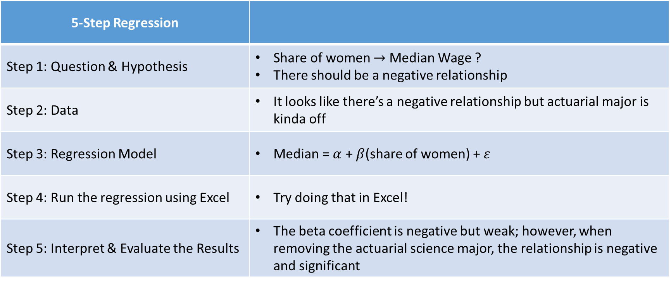
Case Study Summary
5-Step Regression
Step 1: Question & Hypothesis | Share of women $→$ Median Wage ? There should be a negative relationship
Step 2: Data | It looks like there’s a negative relationship but actuarial major is kinda off
Step 3: Regression Model | Median = $α$ + $β$(share of women) + $ε$
Step 4: Run the regression using Excel | Try doing that in Excel!
Step 5: Interpret & Evaluate the Results | The beta coefficient is negative but weak; however, when removing the actuarial science major, the relationship is negative and significant

Slide 77
Review: Regression in 5 Steps
Frame the question & Form the hypotheses
Pick a regression model that could answer the question
Collect, clean, summarize & visualize the data
Use the model in (2) and data in (3) to run a regression
Evaluate & interpret the results
Iterate some or all of steps 1-5 if necessary

Slide 78
Regression Study Guide: No Textbook Needed!
Good background in regression analysis:
การวิเคราะห์ถดถอย Simple Regression
https://www.youtube.com/watch?v=qE_6D4gScs8
Must-See Videos:
การวิเคราะห์ถดถอยพหุ # แนวคิดเบื้องต้น
https://www.youtube.com/watch?v=jEp-0m8_89k
Optional Lecture Note:
Penn State’s Simple Linear Regression Lesson 1
https://onlinecourses.science.psu.edu/stat501/node/250

Slide 79
Basic Regression: Extended

Slide 80
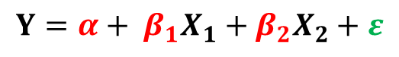
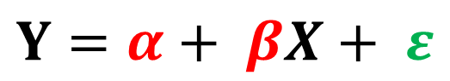
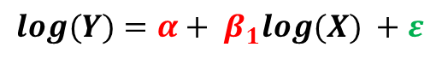
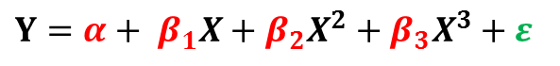
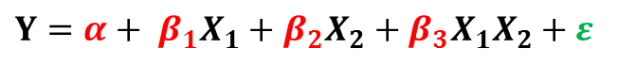
Extension to the Simple Linear Regression Model
Simple Linear Regression
When you have more than one X
When X is categorical
When X can be multiplied with another X
When X or Y is non-linear (polynomial, log etc.)
X represents “types” not “numbers”
$$Y=α+ β_{1}X_{1}+β_{2}X_{2}+ε$$
$$Y=α+ β_{1}X_{1}+β_{2}X_{2}+β_{3}X_{1}X_{2}+ε$$
$$Y=α+ βX+ ε$$
$$Y=α+ β_{1}X+β_{2}X^{2}+β_{3}X^{3}+ε$$
$$log(Y)=α+ β_{1}log(X) +ε$$

Slide 81
Median Wage
Share of Women
Share of Part Time Employees
Unemployment Rate
Share of Employees Graduated with the “Correct” Major
Other Variables…
Many other
variables could
explain
Median Wage too!

Slide 82
We want to simultaneously explain Median Wage with
%Women
%PartTime
%Umemployed
%CollegeJob
Use explanatory (independent) variables…
to explain dependent variables

Slide 83
Remember: Regression in 5 Steps
Frame the question & Form the hypotheses
Pick a regression model that could answer the question
Collect, clean, summarize & visualize the data
Use the model in (2) and data in (3) to run a regression
Evaluate & interpret the results
Iterate some or all of steps 1-5 if necessary

Slide 84
Regression in 5 Steps
Frame the question & Form the hypotheses
Question
Can (1) %Women, (2) %PartTime, (3) %Umemployed, (4) %CollegeJob explain Median Wage
Hypotheses
%Women is negatively correlated with median wage
%PartTime is negatively correlated with median wage
%Unemployed is negatively correlated with median wage
%CollegeJob is positively correlated with median wage

Slide 85
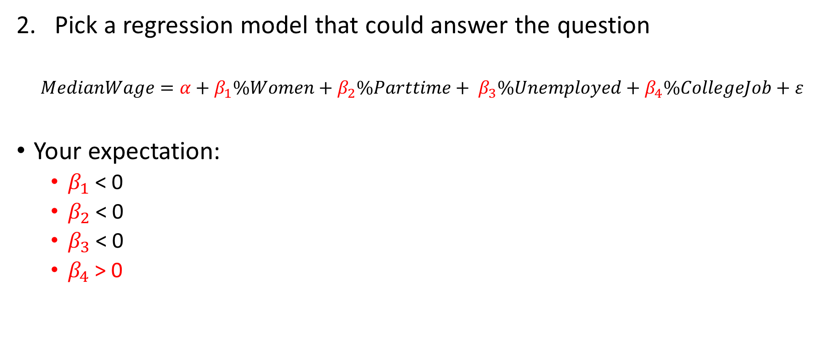
Regression in 5 Steps
Pick a regression model that could answer the question
$$MedianWage=α+β_{1}\%Women+β_{2}\%Parttime+ β_{3}\%Unemployed+β_{4}\%CollegeJob+ε$$
Your expectation:
$β_{1}$ < 0
$β_{2}$ < 0
$β_{3}$ < 0
$β_{4}$ > 0

Slide 86
Regression in 5 Steps
Collect, clean, summarize & visualize the data
Use Data Analysis &…
Descriptive Statistics
Scatter Plot
Correlation ***
Etc.
Watch the videos for detail

Slide 87
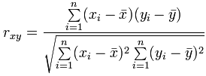
Correlation (r) = Show how variables are related
How to compute correlation in Excel:
Data >> Data Analysis >> Correlation
Correlation Formula
(It is just another summary statistics like mean, variance etc. )
r is between -1 and 1
r > 0: Positive Relationship
r< 0: Negative Relationship

Slide 88

Correlation $≠$ Causation
IMPORTANT
FOOTNOTE
You know whether
X causes Y or
Y causes X
**IT’S A BOLD CLAIM!!
Y & X move together
(same or different direction)

Slide 89

IMPORTANT
FOOTNOTE

Slide 90
Question: Is regression better than correlation?
IMPORTANT
FOOTNOTE
Answer: There are pros and cons
Regression | Correlation
A little harder to estimate | Simpler to estimate
Show both direction & magnitude | Show direction only
Can show many-to-one relationships | One-to-one relationship only
Can disentangle other indirect or joint relationships | Cannot disentangle other indirect or joint relationships

Slide 91
Question: Can a regression model capture ‘causation’?
IMPORTANT
FOOTNOTE
Answer: Not necessary
The usual regression model doesn’t capture causation.
You need a careful regression modeling design to capture the causation effect
Difference-in-difference design
Regression discontinuity design
Instrument variable (IV design)
Random experiment design… just like in the science lab experiment!
Structural modeling design
But that doesn’t mean regression or correlation isn’t useful
My doctoral
research!

Slide 92
Result with One Explanatory Variable
Regression Model:
Median Wage = 52843.66 – 28606.24 x (%Women)
Looking at the data from Arts & Business major recent grads, the “share of women” coefficient is highly significant & negative as before. The Adjusted R Square = 0.26 meaning these variables can explain median wage 26%.

Slide 93
Result with All 4 Explanatory Variables
Regression Model:
Median Wage = 48045.74 – 14409.18 x (%Women)
– 44565.57 x (%Part Time)
+ 13749.36 x (%Unemployed)
+ 26451.96 x (%College Job)
The regression coefficients are highly significant and follow the hypotheses except %Umemployed, however, its coefficient is not significant (p-value = 0.87; higher than 0.1). Adjusted R Square = 0.70 meaning these variables can explain median wage 70%.

Slide 94
Want to Improve the Adjusted R Square? Try dropping the insignificant variable(s)
Regression Model:
Median Wage = 48707.90 – 14440.45 x (%Women)
– 43278.11 x (%Part Time)
+ 27017.69 x (%College Job)
+ 26451.96 x (%College Job)
Once removed the %Umemployed, the Adjusted R Square improves (before 0.70, now = 0.7183) meaning these variables can explain median wage 71.83%... A little better than the previous model

Slide 95
Extension to the Simple Linear Regression Model
Simple Linear Regression
When you have more than one X
When X is categorical
When X can be multiplied with another X
When X or Y is non-linear (polynomial, log etc.)
X represents “types” not “numbers”
$$Y=α+ β_{1}X_{1}+β_{2}X_{2}+ε$$
$$Y=α+ β_{1}X_{1}+β_{2}X_{2}+β_{3}X_{1}X_{2}+ε$$
$$Y=α+ βX+ ε$$
$$Y=α+ β_{1}X+β_{2}X^{2}+β_{3}X^{3}+ε$$
$$log(Y)=α+ β_{1}log(X) +ε$$

Slide 96
We want to explain Median Wage with
%Women,
%PartTime,
%Umemployed,
%CollegeJob
(5) Major Category… not a number!!!
Use explanatory (independent) variables…
to explain dependent variables

Slide 97
How? Convert Text to Number using Dummy Variable

Slide 98
N types = N dummy variables

Slide 99
*** BUT when you run regression, only include N-1 dummy variables in your regression model

Slide 100
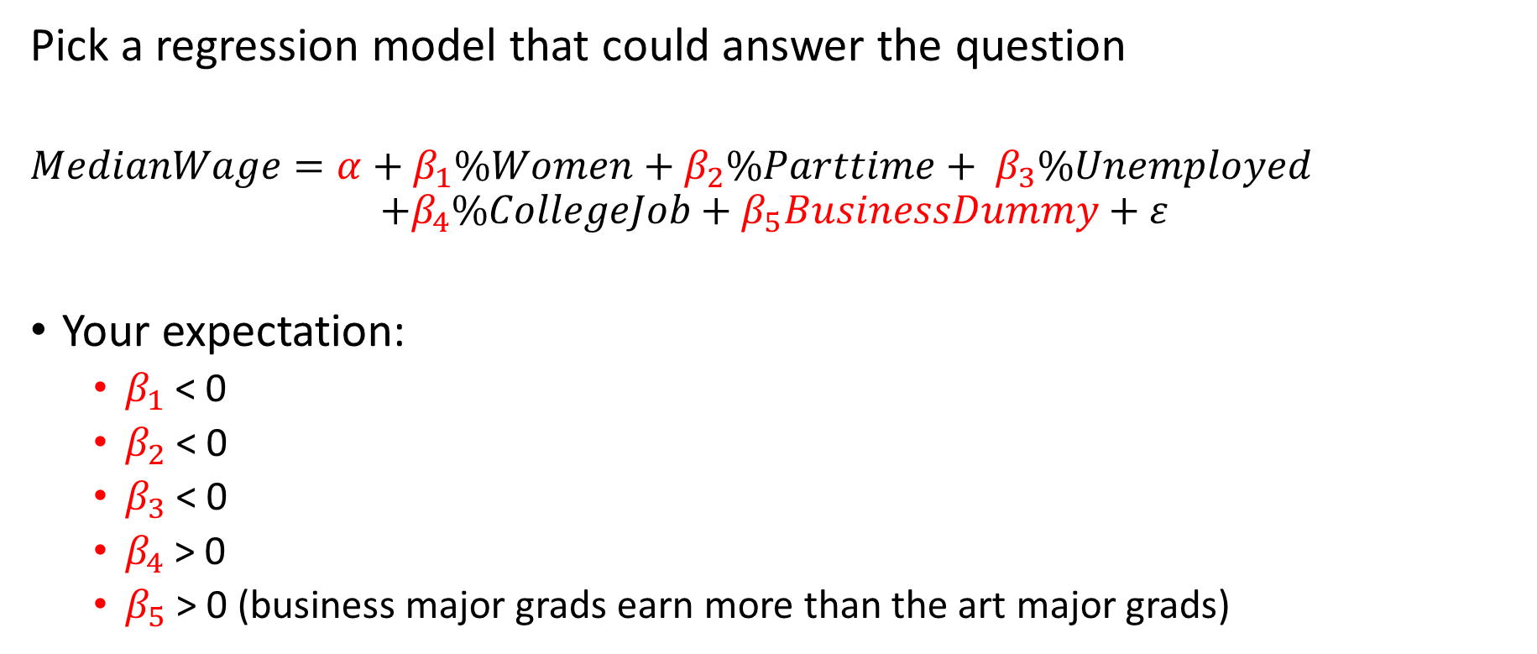
Regression Model & Hypotheses
Pick a regression model that could answer the question
$$MedianWage=α+β_{1}\%Women+β_{2}\%Parttime+ β_{3}\%Unemployed$$
$$+β_{4}\%CollegeJob+β_{5}BusinessDummy+ε$$
Your expectation:
$β_{1}$ < 0
$β_{2}$ < 0
$β_{3}$ < 0
$β_{4}$ > 0
$β_{5}$ > 0 (business major grads earn more than the art major grads)

Slide 101
Regression Model:
Median Wage = 48045.74 + 483.15 x (Business Dummy)
– 14356.20 x (%Women)
– 42430.92 x (%Part Time)
+ 14626.26 x (%Unemployed)
+ 26795.66 x (%College Job)
The regression coefficient for business dummy is positive but not significant (p-value = 0.9484… much higher than 0.1). It means that there’s no significant different between business major recent grad’s & arts major recent grad’s median salary.

Slide 102
Extension to the Simple Linear Regression Model
Simple Linear Regression
When you have more than one X
When X is categorical
When X can be multiplied with another X
When X or Y is non-linear (polynomial, log etc.)
X represents “types” not “numbers”
$$Y=α+ β_{1}X_{1}+β_{2}X_{2}+ε$$
$$Y=α+ β_{1}X_{1}+β_{2}X_{2}+β_{3}X_{1}X_{2}+ε$$
$$Y=α+ βX+ ε$$
$$Y=α+ β_{1}X+β_{2}X^{2}+β_{3}X^{3}+ε$$
$$log(Y)=α+ β_{1}log(X) +ε$$

Slide 103
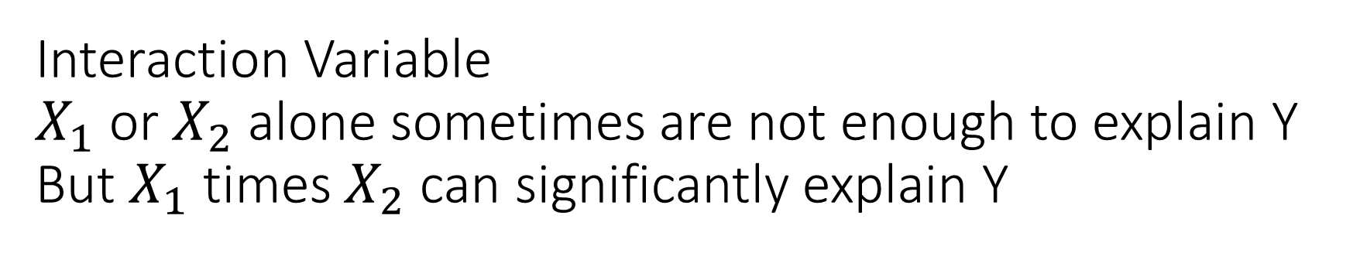
Interaction Variable $X_{1}$ or $X_{2}$ alone sometimes are not enough to explain Y But $X_{1}$ times $X_{2}$ can significantly explain Y
$$Y=α+ β_{1}X_{1}+β_{2}X_{2}+β_{3}X_{1}X_{2}+ε$$
Interaction Variable

Slide 104
Create a new variable called College_PartTime = %CollegeJob x %PartTime

Slide 105
Regression Model:
Median Wage = 50366.46 - 5315.95 x (Business Dummy)
– 19368.97 x (%Women)
+ 8263.19 x (%Part Time)
- 4039.27 x (%Unemployed)
+ 56605.76 x (%College Job)
- 273895.57 x (%College x %PartTime)
The regression coefficient for the interaction variable is negative and significant (p-value = 0.05… lower than 0.1). It shows that part-time job paid less than full-time job among the field with high % of college grads work in their own major.

Slide 106
Extension to the Simple Linear Regression Model
Simple Linear Regression
When you have more than one X
When X is categorical
When X can be multiplied with another X
When X or Y is non-linear (polynomial, log etc.)
X represents “types” not “numbers”
$$Y=α+ β_{1}X_{1}+β_{2}X_{2}+ε$$
$$Y=α+ β_{1}X_{1}+β_{2}X_{2}+β_{3}X_{1}X_{2}+ε$$
$$Y=α+ βX+ ε$$
$$Y=α+ β_{1}X+β_{2}X^{2}+β_{3}X^{3}+ε$$
$$log(Y)=α+ β_{1}log(X) +ε$$

Slide 107
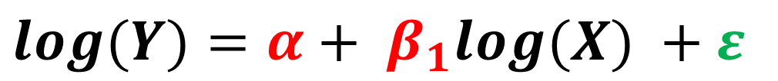
Non-linear Model?
$$Y=α+ β_{1}X+β_{2}X^{2}+β_{3}X^{3}+ε$$
$$log(Y)=α+ β_{1}log(X) +ε$$
And many others…

Slide 108
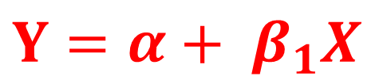
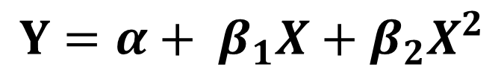
Red Line or Black Line?
$$Y=α+ β_{1}X+β_{2}X^{2}$$
$$Y=α+ β_{1}X$$

Slide 109
The basic linear regression model gives you adjusted r square = 15.8%. It seems fine so far…

Slide 110
However, it’s actually better to include the square term in the model because of the higher adjusted r square & significant squared variable

Slide 111
Key Takeaway

Slide 112
Audience Value Generation
What’s your audience’s goal?
What insights they need to know to inform / make decisions?
How they can generate values using insights?
Data
Acquisition
What
Where
When
Who
How
How Many
Data
Integration
How “dirty”
is your data?
Analysis
List out exact
questions
and variables/models
needed
Potential bias and error
traps?
Delivery
Key visuals
Key statistics
Key takeaways
Data
Creator
Audience
Data Governance
Does your organization promote behaviors for good data practice?
Data Principles / Quality / Privacy / Life Cycle / Ethical Use

Slide 113
ถามไปทำไม
ผู้รับสารจะได้อะไร
ถาม
ชัด
วัดได้
ไม่ซับซ้อนเกินไป
เก็บ + ต่อยอด
มันแปลว่าอะไร
ใช่จริง ๆ มั้ย
เจอ
เจอ Insight อะไรใหม่มั้ย
ทำไมถึงไม่เจอ
ไม่เจอ
ทิ้ง

Slide 114
กรอง
เจาะ
เทียบ
ชน
เอาข้อมูลที่
“ไม่สำคัญ” หรือ “สกปรก” ออกไป
ดูตัวแปรเดียวอย่างละเอียด เช่น ความถี่ ผลรวม ค่าเฉลี่ย การกระจายข้อมูล ตำแหน่งข้อมูล
เปรียบเทียบระหว่างตัวแปรเดียวกันในหลายประเภท/ชนิด หรือดูสัดส่วน
ดูความสัมพันธ์ระหว่างตัวแปรสองตัวขึ้นไป

Slide 115
Gain Deeper Insights with Regression Analysis
Simple Linear Regression
When you have more than one X
When X is categorical
When X can be multiplied with another X
When X or Y is non-linear (polynomial, log etc.)
X represents “types” not “numbers”
$$Y=α+ β_{1}X_{1}+β_{2}X_{2}+ε$$
$$Y=α+ β_{1}X_{1}+β_{2}X_{2}+β_{3}X_{1}X_{2}+ε$$
$$Y=α+ βX+ ε$$
$$Y=α+ β_{1}X+β_{2}X^{2}+β_{3}X^{3}+ε$$
$$log(Y)=α+ β_{1}log(X) +ε$$

Slide 116
Question?

